Slide 1
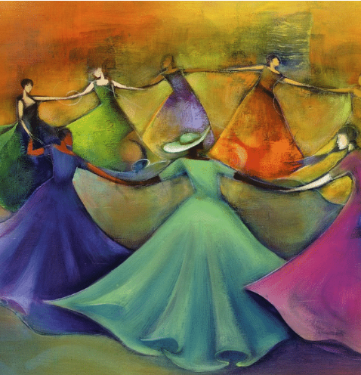
A Blessing Prayer for Nollaig na mBan
We pray for all the women in our lives - mothers, wives, grandmothers, sisters, daughters, friends.
“May your home be trimmed with love
With joy wound 'round and round,
May laughter raise the rafters
And merriment abound
May your hearth glow with the smiles
Of all your kith and kin,
And may heaven grace your humble place
As the good Lord dwells within.”

Slide 2
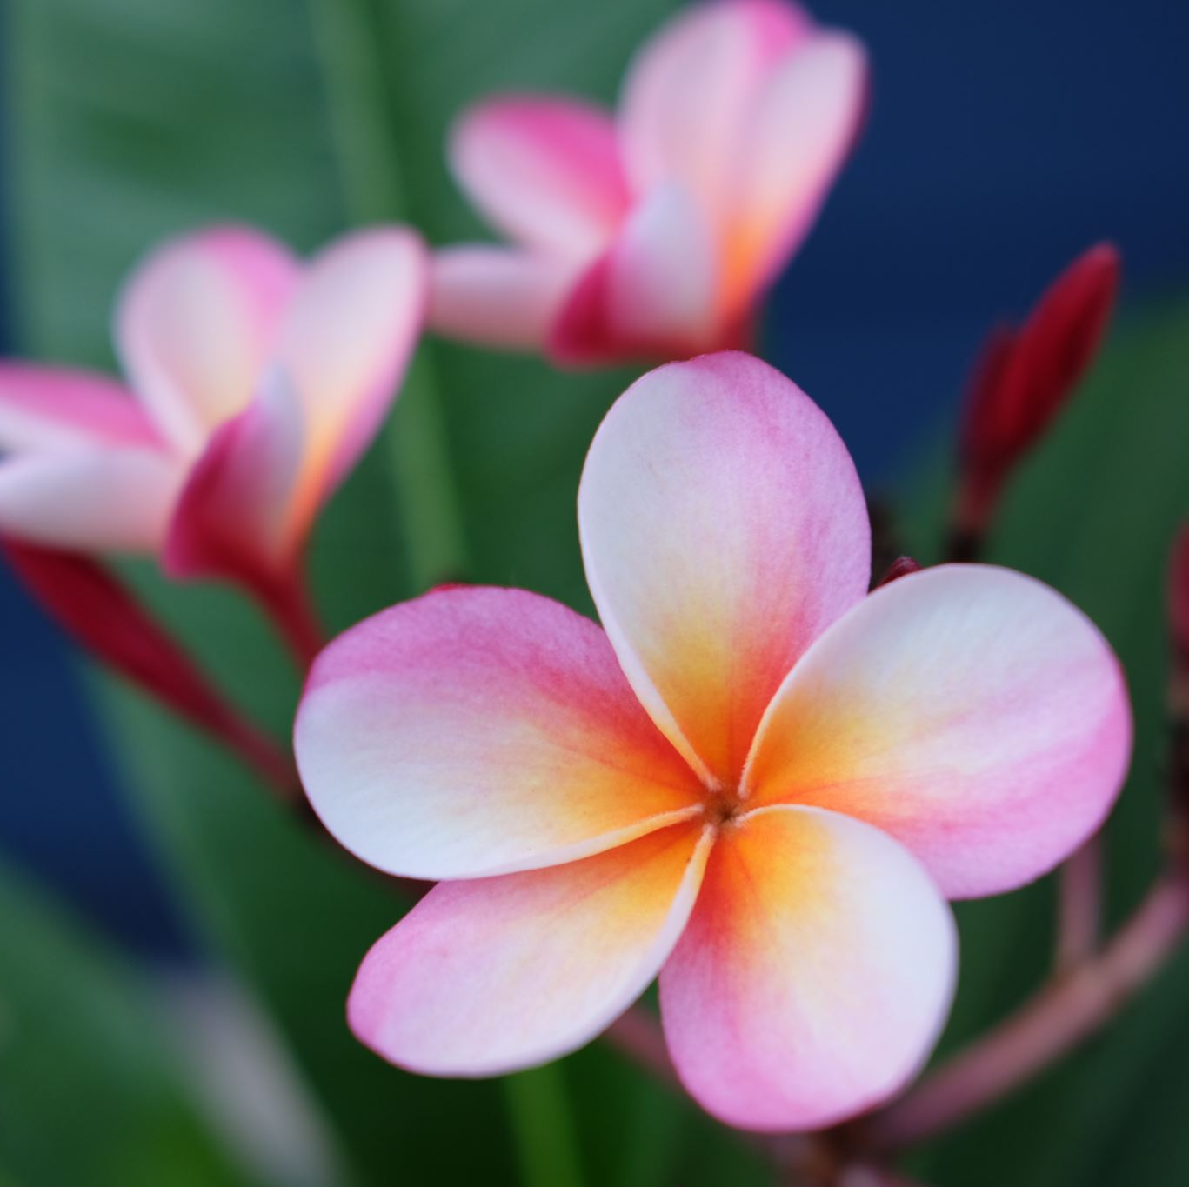
Entering the New Year
God of all time,
help us enter the New Year quietly,
thoughtful of who we are to ourselves and to others,
mindful that our steps make an impact
and our words carry power.
May we walk gently.
May we speak only after we have listened well.
Creator of all life,
help us enter the New Year reverently,
aware that you have endowed
every creature and plant, every person and habitat
with beauty and purpose.
May we regard the world with tenderness.
May we honor rather than destroy.
Lover of all souls,
help us enter the New Year joyfully,
willing to laugh and dance and dream,
remembering our many gifts with thanks
and looking forward to blessings yet to come.
May we welcome your lavish love.
May we cast off the small, vindictive god our fears have made.
May the grace and peace of Christ bless us now and in the days ahead.
- Vinita Hampton Wright

